Slide 1
Agricultural Data Localization for Standardization & Interoperability
Presenter: Anastasia Wahome
Organization: RCMRD/SERVIR E&SA

Slide 2
Background & Objective
Regional institutions in East Africa play an essential role in food security data storage, analysis, dissemination, and training.
COVID-19 magnified bottlenecks in local data infrastructures inhibiting early warning action, and stalling countries’ journey to self-reliance.
Opportunity to leverage existing data, systems, networks in the agriculture landscape, e.g. between FEWSNET and SERVIR.
SERVIR and FEWSNET have already been developing application ready data available through visualization portals and data warehouses (FEWS Data Warehouse, EWX) – opportunity to add value by transforming existing data into specific information packages targeting specific agriculture decisions (Analysis Ready Data (ARD).
Overall Objective: to create analysis ready data for food security & early warning decision from existing data resources making, while influencing dialogues on openness in data, methods and systems.

Slide 3
Implementation Plan/Activities
Capacity development on Data collection & management
Develop ARD+ outputs
Learning, documenting successes and lessons
Transitioning progress to countries & enabling partners
Dialogues & high level communications on country actions
Consultations, mapping actors, identify needs & priorities
Collaborations for development. Country specific recommendations 4 data standards & interoperability

Slide 4
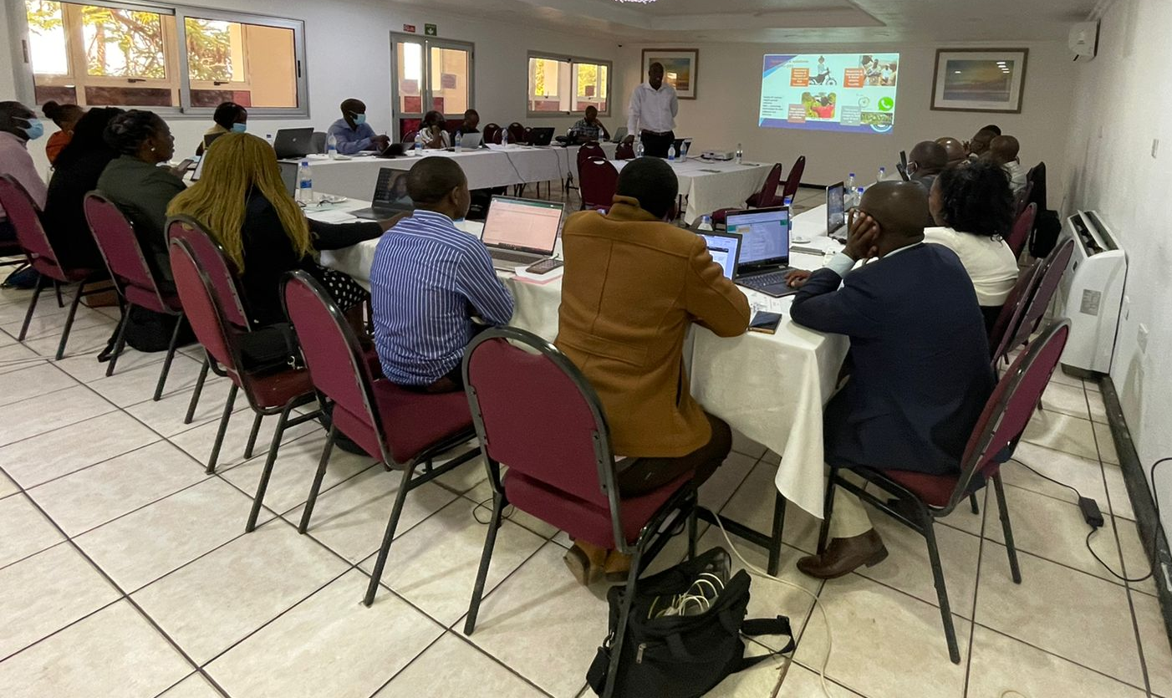
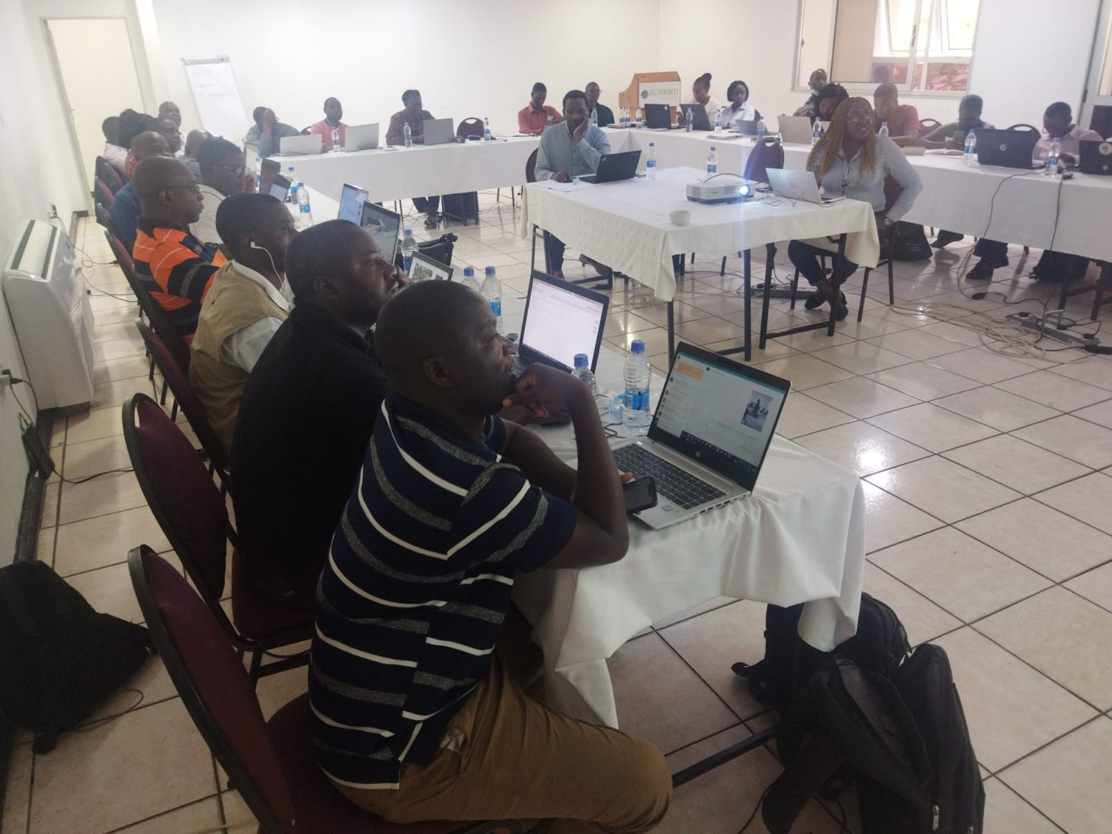
Stakeholders’ Consultations
Stakeholder mapping
Identify needs and priorities
Strengthening the use of data standards to improve quality of Ag data
Collaborations with data collectors, data providers, enabling institutions, policy actors
Work with organizations developing standards for ag data management
to identify minimum data requirements
Standards for ensuring interoperability, openness

Slide 5
Capacity Building
Aimed at strengthening the quality of agricultural data collection and management practices.
Be able to apply data quality standards during data collection, storage and publishing
Improve openness and data interoperability by providing awareness and sensitization on data standards, metadata, openness and interoperability.
Targeted technical data officers, data managers and GIS officers involved in agricultural data collection and management
Methodology - interactive presentations and tutorials including practical sessions.
Real-time data collection, storage and access
Open Data Access &
Standards
Metadata and metadata publishing tools

Slide 6
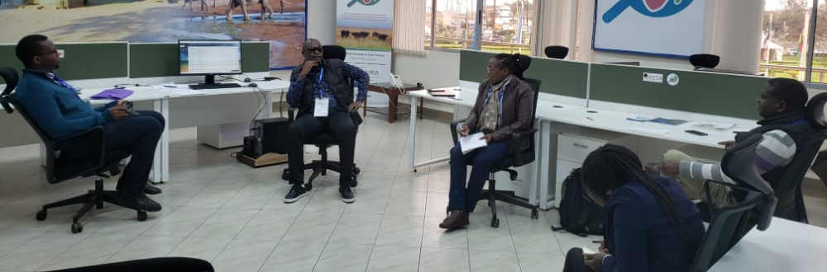
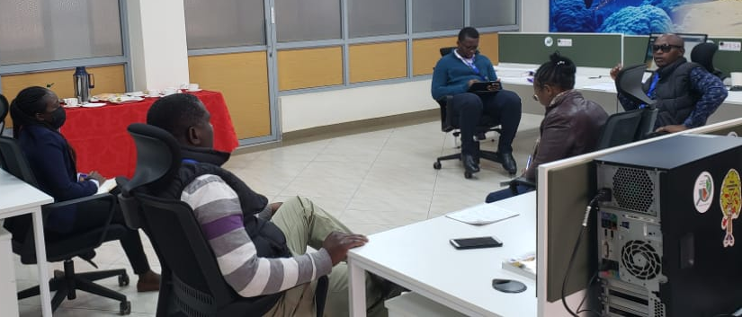
Dialogues & High-level Communications
Communicate to High Level Actors and Key policy stakeholders on agreed country recommendations and actions for strengthening agricultural data management
Support for implementing identified country actions
Engage on sustainability mechanisms and collaborations for sustaining the country actions, incl. alignment with existing funds/projects/organizations

Slide 7
Learning Exchange
Increase:
Awareness
Resources
Collaborations
SHARE:
Best practices
Pathways to success
Innovations
Sustainability options
ENGAGE:
Review guidelines
Develop country specific recommendations & Actions
DEMONSTRATE:
Connections
Progress
Value for investments

Slide 8
Outputs
Guidelines for Minimum Data Requirements
Pilots & Use cases
Decision Ready outputs
DEVELOP
Training Modules
Guidelines for conforming to Standards

Slide 9
Results
Sample Minimum Parameters
Survey date: Date of survey
Field Location: (GPS coordinates)
District name, Village name – admin area to the lowest level
Dominant crop: Dominant crop in the field
Water source: Rainfed or irrigated (yes/no).
Purpose: Subsistence or commercial
Planting Date : The date the field was planted
Harvest Date: The month the field is expected to be harvested or was harvested?
Farm Size: Size of the farm in hectares
Photo
Needs assessments
Inadequate capacity (skills and knowledge)
Emerging data collection technologies are not adequately used
Poor harmonization of standardization of statistical methodologies between agencies collecting agricultural data
Low prioritization in funding decisions that limits improvement in the collection and analysis of agricultural statistics
Lack of efficient data platforms for processing, analysis and sharing
Training on agricultural data standardization and interoperability
80 trained in 6 countries (Malawi -12, Zambia – 15, Tanzania - 11, Rwanda - 18, Kenya - 11,Uganda - 13)
Pilot data collection – Kenya set to pilot digital data collection tools
Development of analysis ready data
Leverage existing tools
Data sharing for development and calibration of yield estimate models
Preliminary outputs for Kenya, Malawi, Zambia & Tanzania

Slide 10
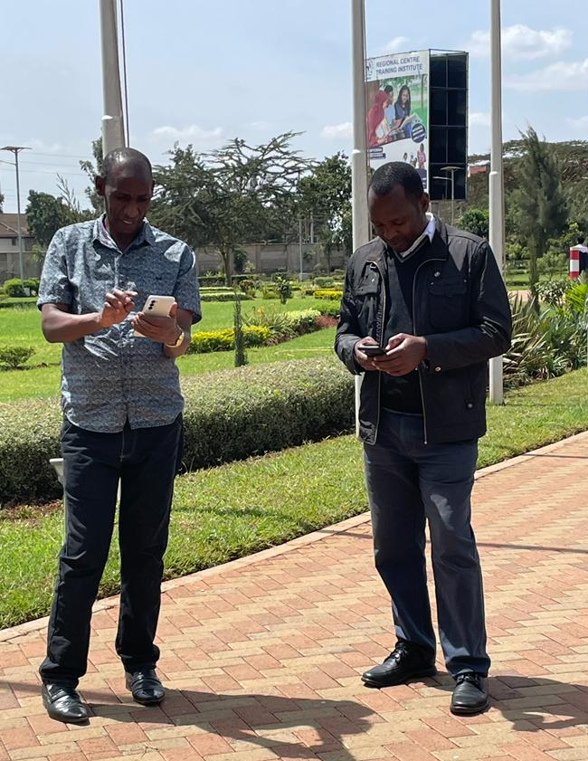
Expected Outcomes
Increased efficiency in the data collection/MIS systems
Data will be more readily linked to EO derived outputs
Data will be more inter-operable & available for decision making.
Improved decision specific support outputs that go beyond Application Ready Data (ARD) (EO data dissemination Portals)
Increased collaboration on standards for data collection, documentation, & sharing to improve interoperability of data systems in the region
Document, Learn, Share best practices and innovations for overcoming existing challenges

Slide 11
Collaborators, Stakeholders and Users
Regional and National Food Security institutions and government agencies
Ministries of Agriculture
Agricultural Research Institutes/Organizations
Meteorological Agencies
National Statistics Agencies
FEWSNET
East Africa Grain Council (EAGC)
FAO
The Regional Network of Agricultural Policy Research Institutes (ReNAPRI)
International Institute of Tropical Agriculture (IIAT)
World Food Programme (WFP)
CIAT

Slide 12
Thank you
Questions?

